Slide 1
CONFERENCE PROPOSAL
EDU 9800 Technology for Research
Dr. Elsa-Sofia Morote
Presented by Benedict Tieniber

Slide 2
About Me
EDUCATION
PROFESSIONAL EXPERIENCE
June 2012, began attending the Doctor of Education (Ed.D) Executive Degree Program in Educational Administration at Dowling College
Doctoral courses in Higher Education at Walden University
Master of Science in Adolescence Education
Concentration in Business at Dowling College
Bachelor’s of Science in Business Administration
Minor in Economics at St. Joseph’s College
Owner of a catering company called
Most Valuable Catering since 2005
Certified NYS Teacher in Business
Leave replacement at Islip High School
Substitute teacher at Islip UFD and Connetquot UFD.
Certificate in Work-based learning
Educational Committee for the Rose Brucia Education Foundation “reducing child abductions”

Slide 3
SITE 2013
Society for Information Technology and Teacher Education
Teaching with Technology:
Engaging Students through 21st
Century Learning
March 5th-9th, 2012
Austin, Texas

Slide 4
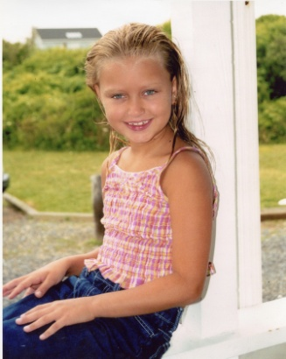
Problem Statement
Determining the impact on stranger safety awareness of students grades k-8 by the type of a educational program designed specifically to enhance stranger safety skills: The Rose Brucia Educational Foundation

Slide 5
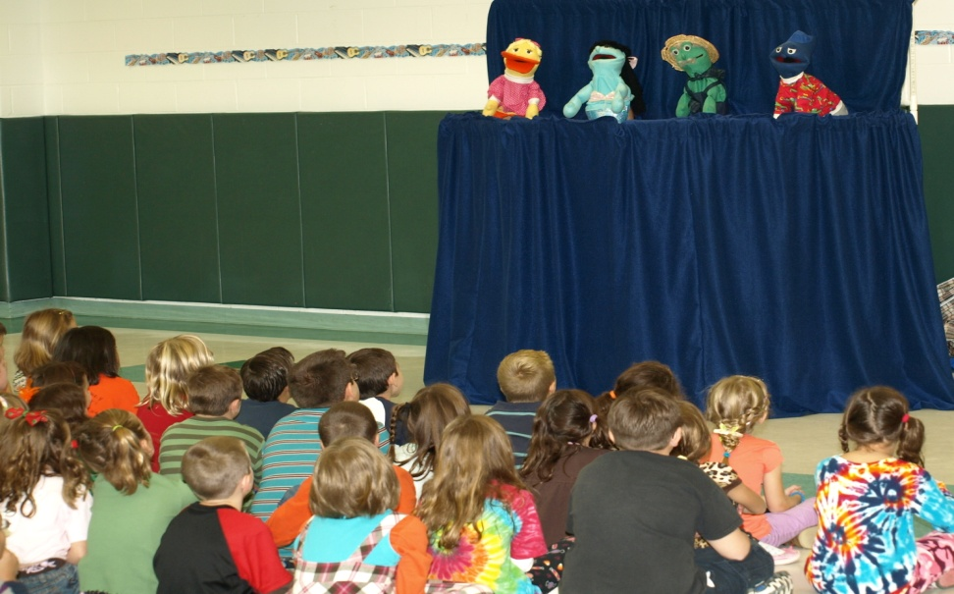
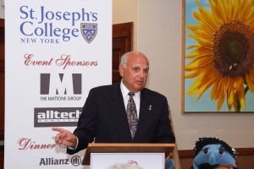
Two ways
PUPPET SHOWS
EDUCATIONAL CURRICULUM
The Foundation presents two short puppet shows, written by the Community Health Department of Good Samaritan Hospital Medical Center, focusing on simple, realistic tips for children that educate and empower young minds.
The educational committee instruct parents about how to review the information presented in the classroom to reinforce the messages of Awareness, Safety & Trust to their child.

Slide 6
Literature Review
“The Rose Brucia Stranger Safety Awareness Program is a free educational curriculum designed to provide vital, proactive stranger safety awareness techniques to elementary-aged children. The program includes single-concept video shorts in conjunction with suggested lesson plans, written by teachers, for teachers, to actively involve children in their own safety as it relates to strangers “(Education Letter, 2012).
“Tim Bishop, New York Representative, says we send our kids off to school, or when they walk home from whatever it is they’re doing after school, we want to have a sense of confidence that they’re safe. We also want them to know and have the tools that they need. I have great hope in the impact [this program] will have for thousands and thousands of families” (Sachem Patch, 2011).

Slide 7
Literature Review
“The Stranger Safety Awareness Program, focuses on three fundamental concepts: Awareness, Safety and Trust. Utilizing Health and Safety Standards established by New York State, the program is designed to reflect these principals consistently throughout all the lessons. The core messages are presented in simple DVD format with individual lesson plans written around each show. They are designed to deliver vital stranger safety concepts to children in a non-threatening, yet thought provoking manner. Each lesson plan includes a checklist of short-term and long-term objectives for the teacher to use as a guide, a list of materials needed to teach each lesson as well as summary statements and suggested homework assignments.” (Barbis)

Slide 8
Literature Review
Sometimes there are people who trick or hurt others. No one has the right to do that to you. So use these rule: 1. Check first with my parents, guardians, or other trusted adults before going anywhere, helping anyone, accepting anything, or getting in a car.
2. I take a friend with me when going places or playing outside.
3. I TELL people ‘NO’ if they try and touch me or hurt me.
4. I TELL my trusted adult if anything makes me feel sad, scared, or
confused (National Center for Missing and Exploited Children, 2010).
“Determine whether traditional child safety messages are effective or adequate. Examines the three basic premises underlying child safety messages—stranger danger, being a tattletale, and respecting adults—and how they may make children move vulnerable rather than less” (Allen, 1998)

Slide 9
Design
Sample: parents and students (k-8)
Training:
Pre-post test on puppet shows for students
Students handed coloring books with stranger safety theme
Parents given material to go over with children after child-parent video presentation

Slide 10
Future Implications
To reduce the number of child abductions in the U.S. by educating and empowering young minds with the knowledge necessary to avoid abduction.
Utilizing puppets and a formalized educational curriculum, the foundation provides elementary-age children with the Stranger Safety Awareness Program.
Administration requires their school districts to assess the baseline of stranger safety awareness of students grades k-8 by an educational program designed specifically to enhance stranger safety skills: The Rose Brucia Educational Foundation.

Slide 11
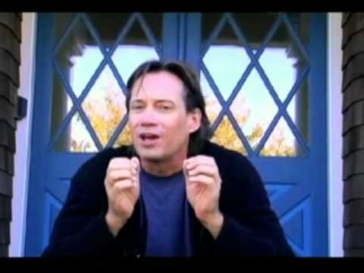
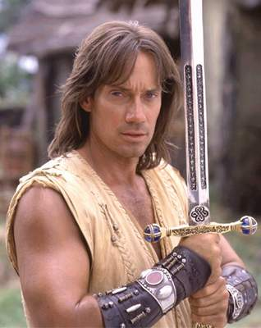
PSA from Kevin Sorbo
Actor Kevin Sorbo provides safety tips for children

Slide 12

PSA from Mike Bossy
Mike Bossy, former NHL New York Islanders Hockey star, with Matt Barbis, founder of the Rose Brucia Educational Foundation, teach Stranger Safety in the Arena. This Public Service Announcement appears on the Jumbotron at the Nassau Veterans Memorial Coliseum in Uniondale, NY during breaks at New York Islander Games

Slide 13
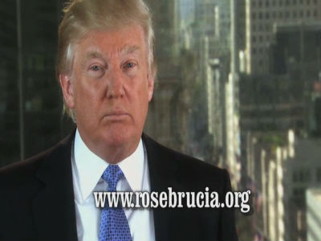

PSA from Donald Trump
Donald Trump declares, "I Practice Stranger Safety". A new, very powerful message urging parents & teachers to download the free Rose Brucia Stranger Safety Awareness Program to proactively teach children everywhere how to avoid abduction.

Slide 14
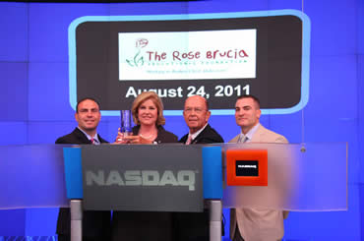

Sue Herera and Wilbur Ross

Slide 15
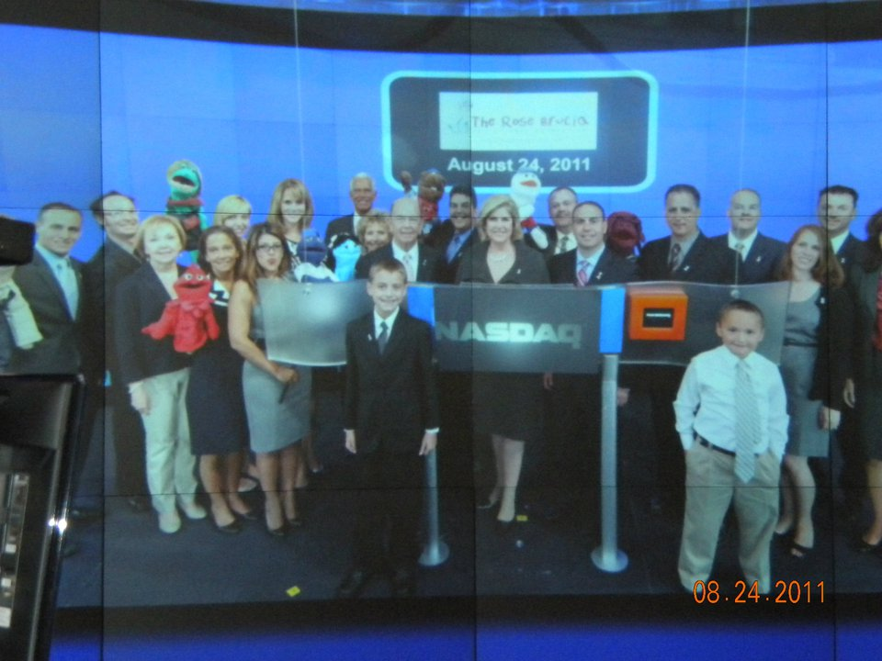
August 22 was officially named Stranger Safety Awareness Day-NATIONALLY

Slide 16
References

